Slide 1

CORE 100: Diversity & Difference - Heartbreak
Wright; Two Cities; Belonging
Stacy DeRuiter
With thanks to Prof Rebecca DeYoung

Slide 2
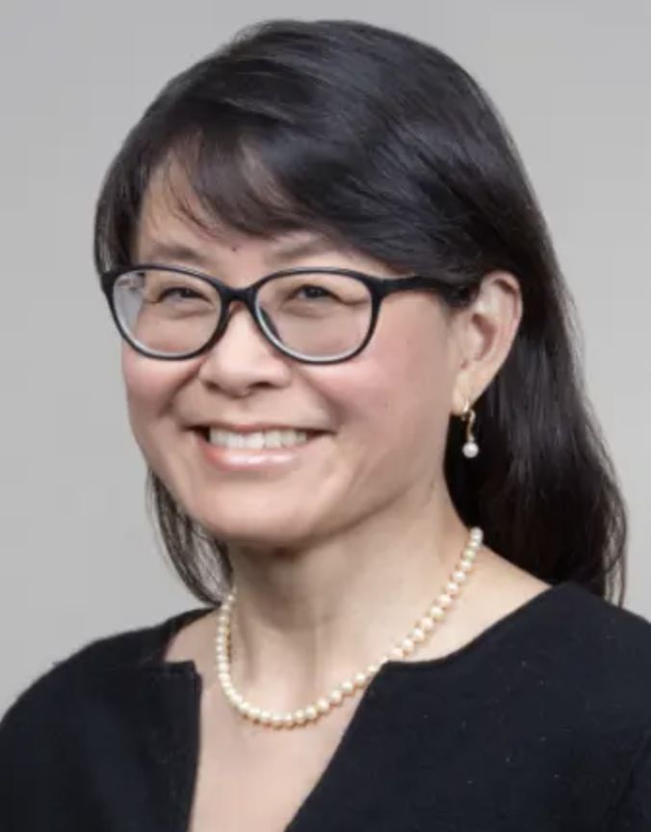
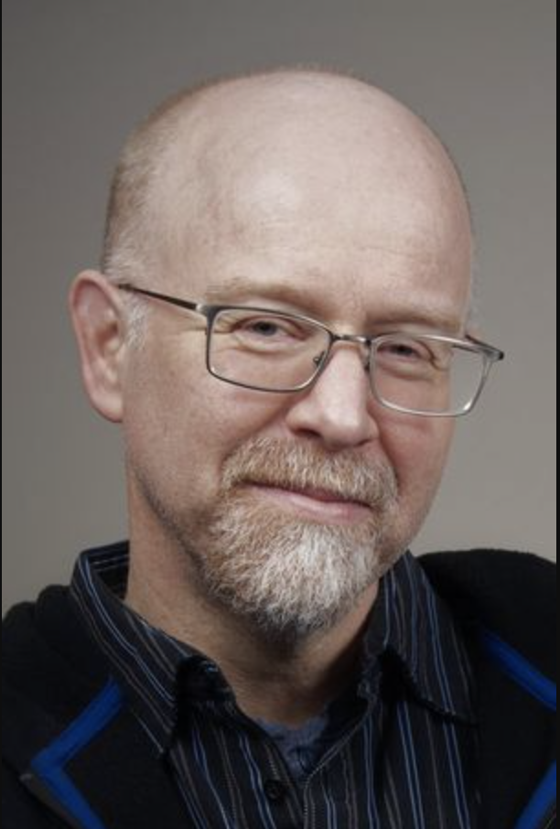
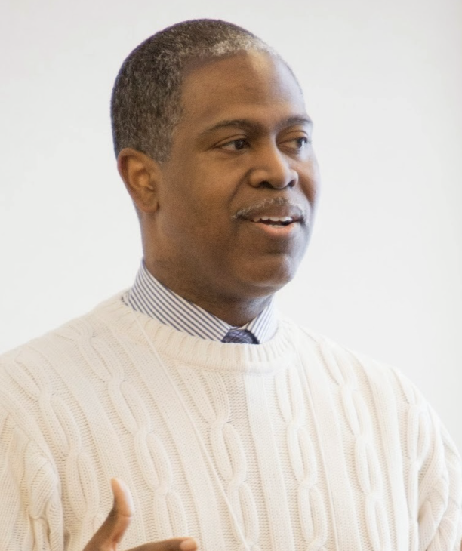
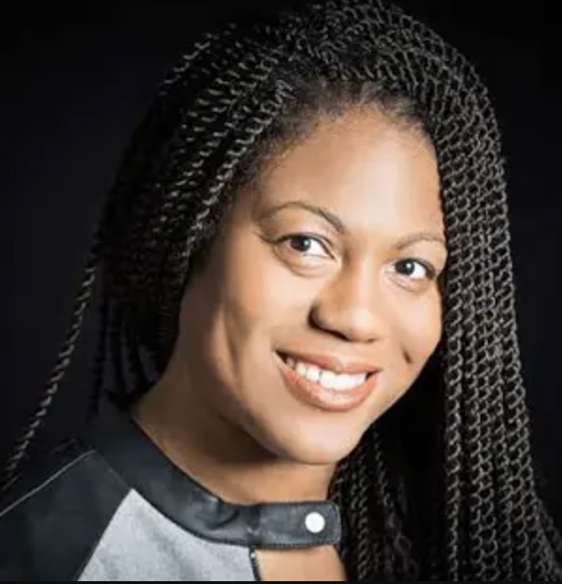
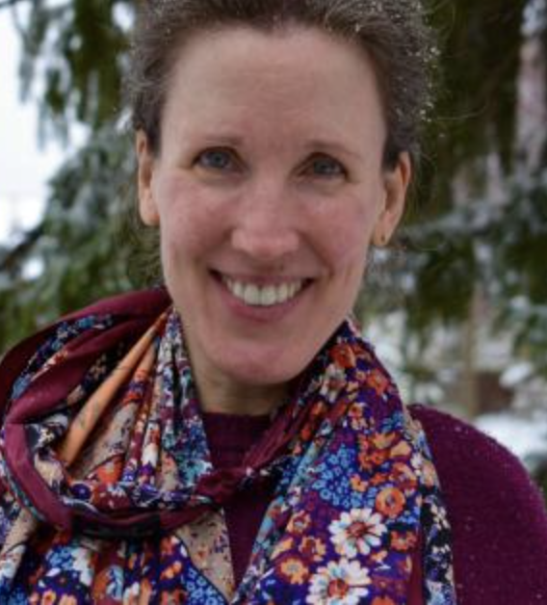
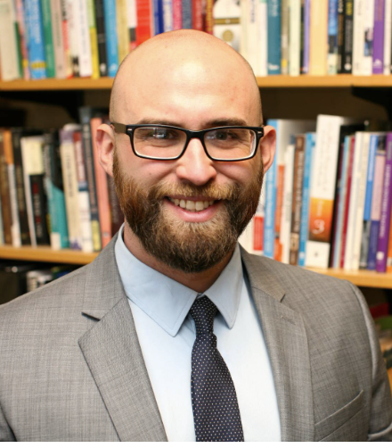
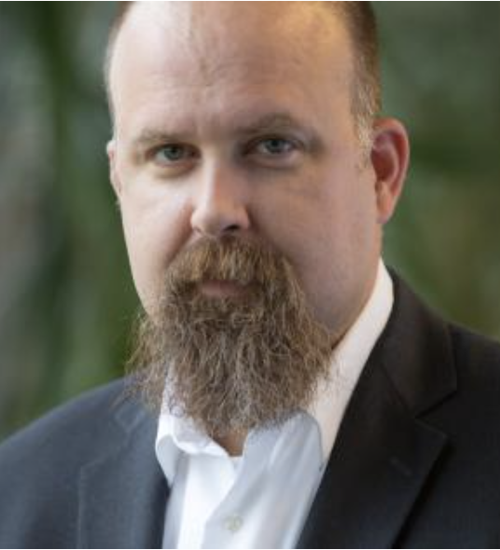
Austin Channing Brown
Pennylyn Dykstra-Pruim
Will Katerberg
Eric Washington
Alisa Tigchelaar
Micah Watson
Joe Kuilema

Slide 3
New Teams! Back of Room
Dean, Annelise, Alexis, Jimmy
Jaden, Will, Nathan, Ronald
Leah, Luke, Nicholas, Brooke
Valeria, Olivia, Tanner
Lily, Lilroy, Emma, Andy
Ava, Josh, Ben, Kaylynn
Front of Room

Slide 4
Let’s Disagree
Consider the outline of Wright’s points from Ch. 6-7, 9-10
Can you find a place where you disagree with my summary (I missed something or mis-characterized something)?
Can you find ideas of Wright’s that another of the author’s we’ve read would likely disagree with?
Are there ideas of Wright’s that you personally disagree with?
In any of those cases – what’s your evidence?

Slide 5
Psalm 87
¹ He has founded his city on the holy mountain. ² The Lord loves the gates of Zion more than all the other dwellings of Jacob.
³ Glorious things are said of you, city of God:^{[a]} ⁴ “I will record Rahab^{[b]} and Babylon among those who acknowledge me— Philistia too, and Tyre, along with Cush^{[c]}— and will say, ‘This one was born in Zion.’”^{[d]} ⁵ Indeed, of Zion it will be said, “This one and that one were born in her, and the Most High himself will establish her.” ⁶ The Lord will write in the register of the peoples: “This one was born in Zion.”
⁷ As they make music they will sing, “All my fountains are in you.”

Slide 6
HOW do we….
Take notes while reading?
Author | General Topic | Main Claims | Reasons And Evidence | My Q’s
Read?
https://fs.blog/how-to-read-a-book/#learn_to_read
Elementary
Inspectional
Analytical
Syntopical

Slide 7
Framing Questions
Who am I? (What is my true identity?)
Forged in crisis
Where is my (true) home?
Asked in exile
In what do I put my ultimate hope?
Confronted by loss/threatened by despair, what center holds?
Where (with what community) do I belong?
Around what common ultimate objects of love will we organize and order our lives?

Slide 8
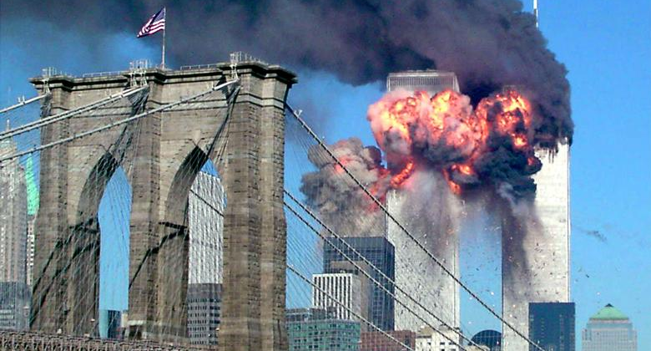

Slide 9
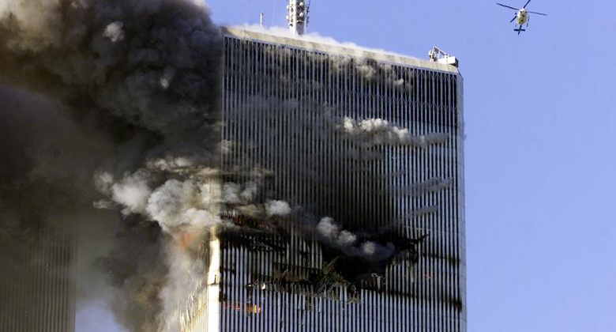

Slide 10
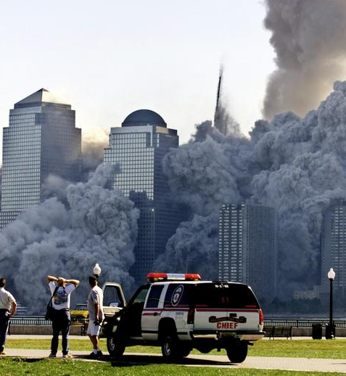
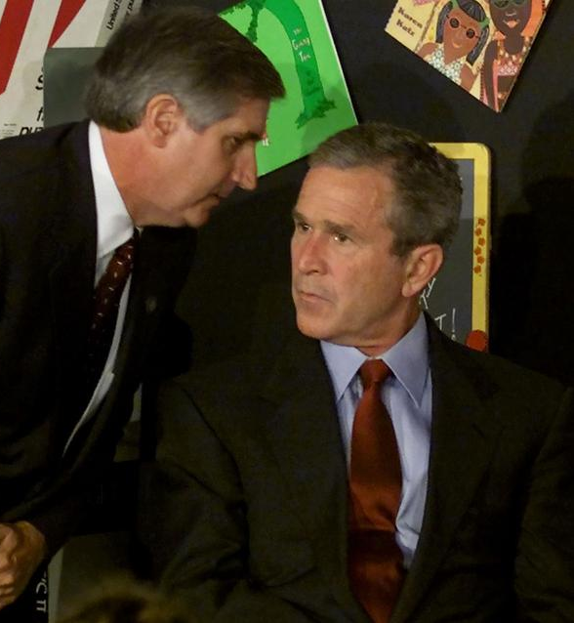

Slide 11
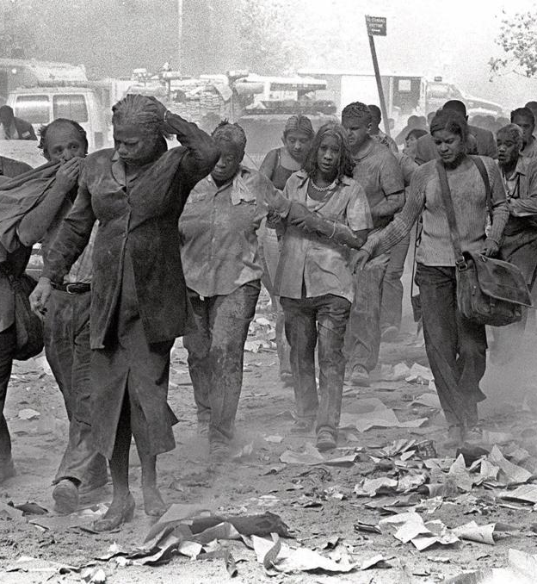
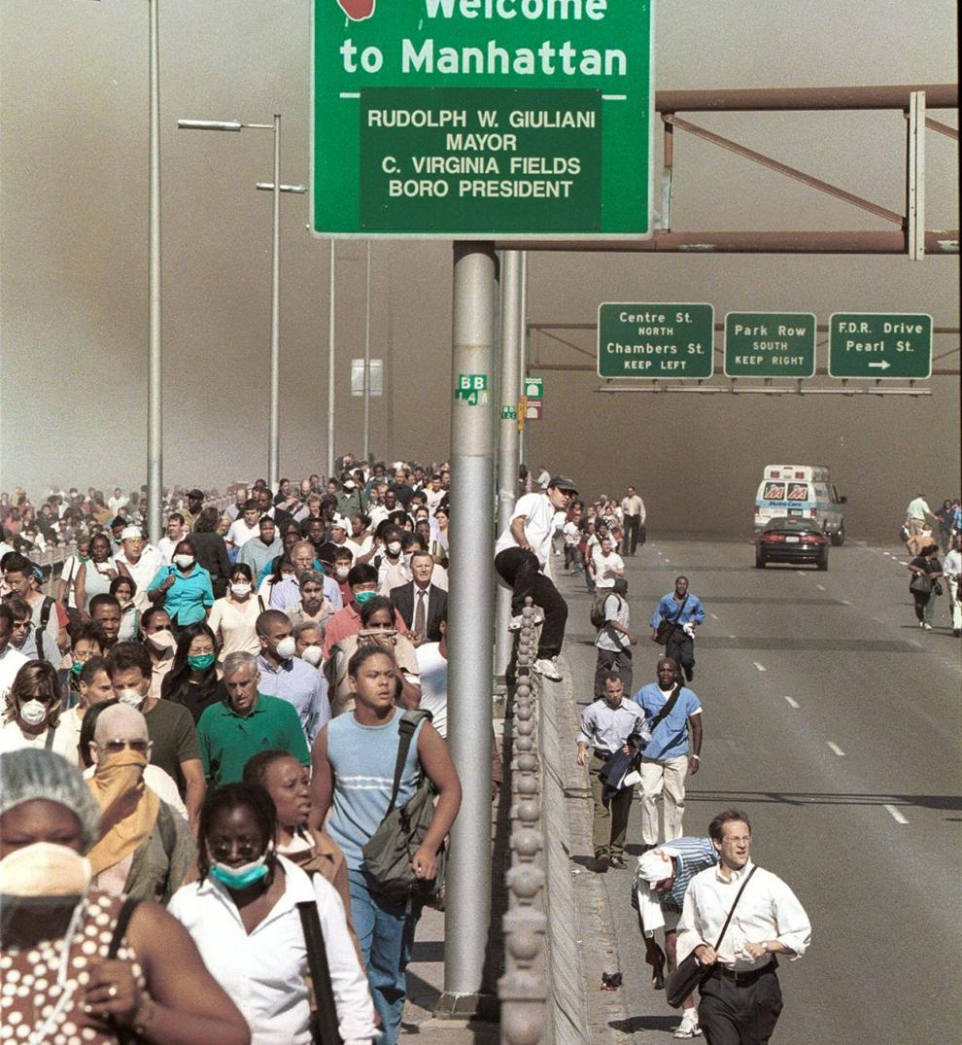

Slide 12
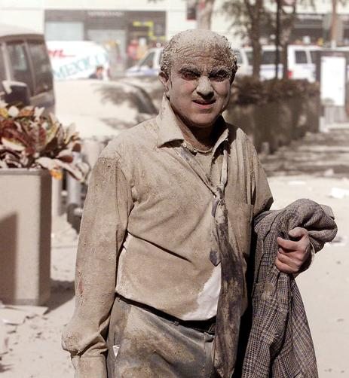
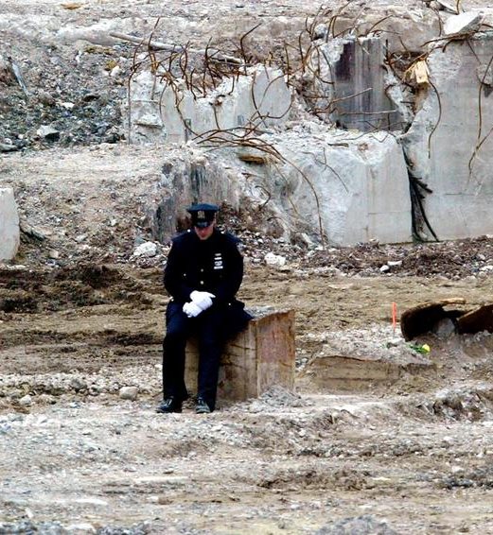

Slide 13
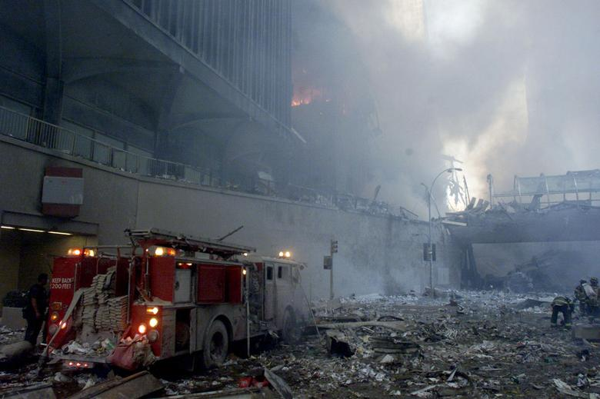
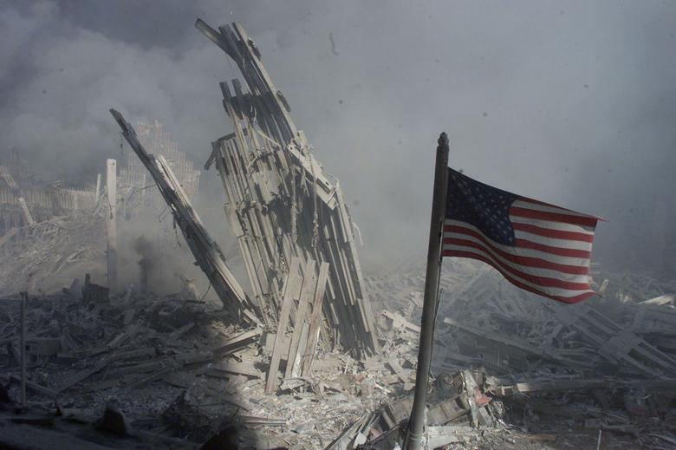

Slide 14
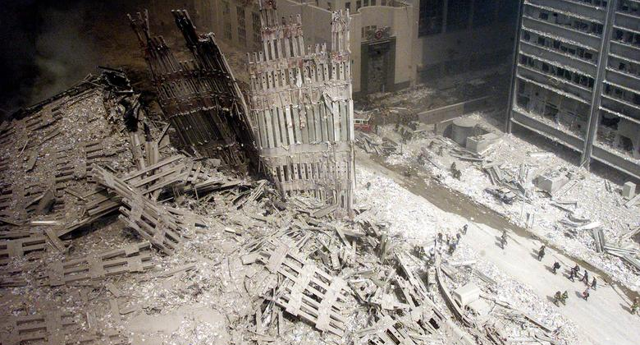

Slide 15
Framing Questions
Who am I? (What is my true identity?)
Tested in crisis, asked in the rubble of my former self?
Where is my (true) home?
Asked in exile, or as a fleeing refugee
In what do I put my ultimate hope?
Confronted by loss/threatened by despair: what center holds?
Where (with what community) do I belong?
Around what common ultimate objects of love will we organize and order our lives?

Slide 16
Augustine’s magnum opus
Written late in life (up to the end)
Took 13 years: 413 (Books I-III)-426 (the rest)
Goth armies sacking Rome, refugees fleeing to N. Africa
Civilization as they knew it—threatened, undermined
An identity crisis…
Augustine’s answer to their fearful questions:
Where is my HOME? (where/how do I live?)
Where can I put my HOPE? (what/how do I love?)

Slide 17
His Answer: An Assurance—
Civilizations rise and fall, but God’s city lasts forever
Don’t overidentify church with empire (earthly institutions)
Your true identity is not threatened
Your membership is intact
Your calling hasn’t changed

Slide 18
The Two Cities
Names:
Jerusalem Babylon
The heavenly city The earthly city
Civitas dei Civitas mundi
The City of God The city of this world
[note: “city of Man”]
What they are NOT: earthly places, historical institutions, political/social orders (nations or countries), or times—this planet/temporal life now vs. “heaven”/everlasting life later

Slide 19
What are the TWO CITIES then?
2 fundamental, ultimate orderings of love & loyalty
A condition of your heart that pervades all areas of life and all of your engagement in it
Think of citizenship as your fundamental identity
Each city is bonded together by a Common Object of Love, the greatest love of its citizenry
Book XIV.28 [can guess citizenship by the way you live]
God Self
God’s glory & power Your own glory & power

Slide 20

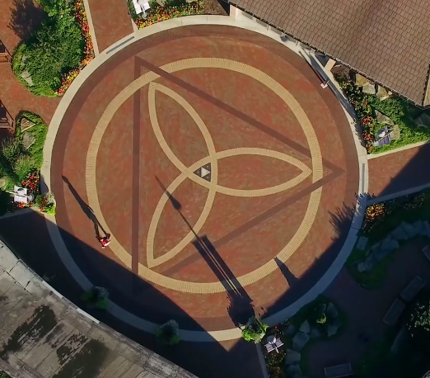

One heart, two possible objects: creation OR Creator
Building a better neighborhood park, designing a better app, helping a patient through a procedure, teaching literature in high school (common projects)
Augustine: done with different ultimate LOVES

Slide 21
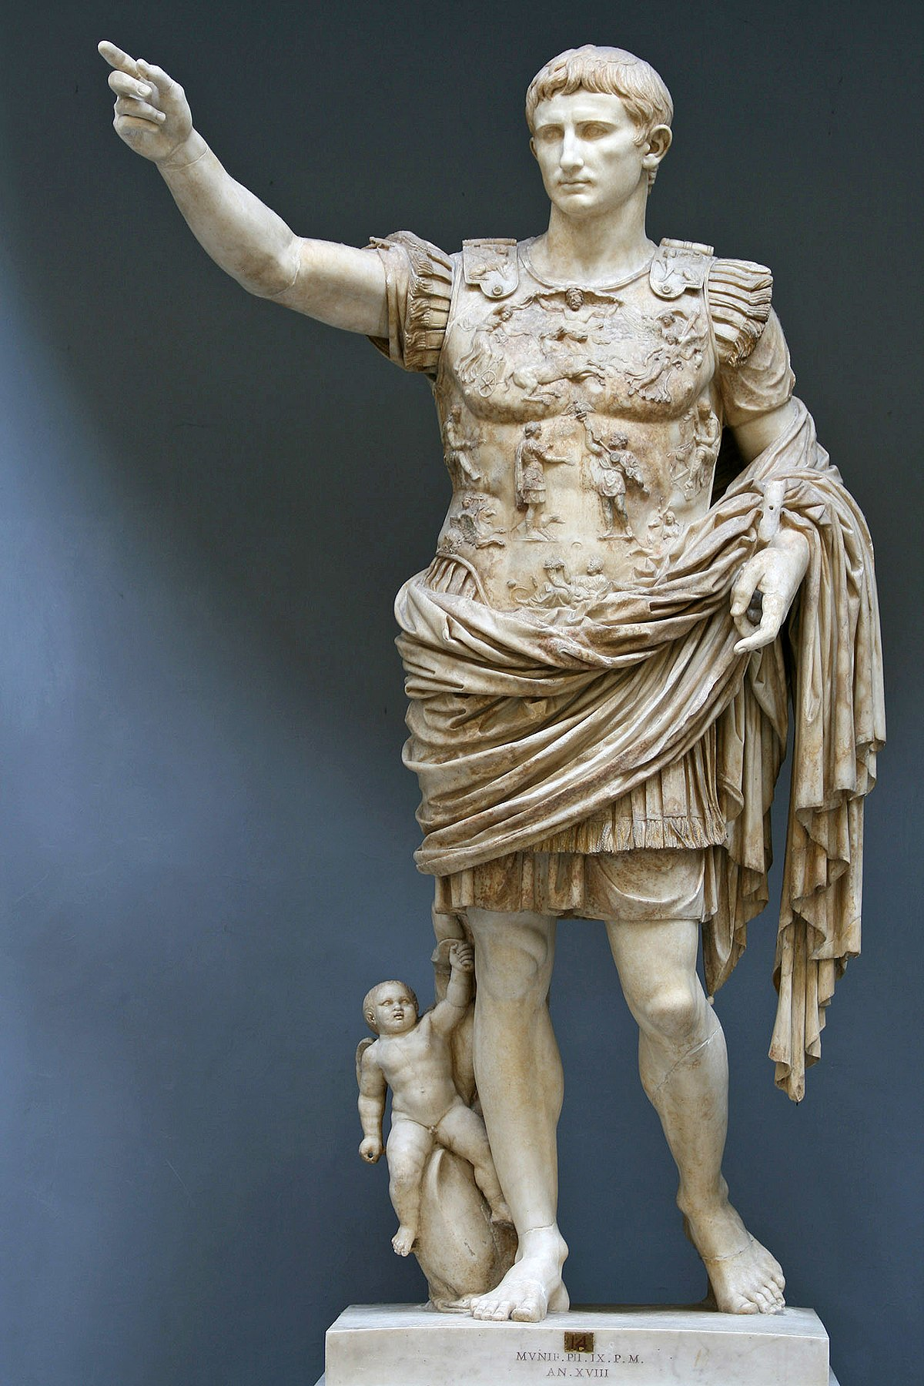

Earthly citizens, heavenly citizens
Libido dominandi: building my kingdom
To make my name great & glorious
“Yours is the kingdom, and the power, and the glory forever”

Slide 22
Examples… [brainstorm]
Godly citizens in earthly city institutions/places
Hopeful possibilities for transformation!
Earthly citizens in God-aimed institutions
Dangers even for the ostensible ‘Christian’ !

Slide 23
How then shall we live? “be otherworldly in the world” (Peter Brown)
“Homesick”: on a journey but not there yet, hope/longing
As peregrini (“pilgrims”, “resident aliens”, “temporary residents”
Abraham in Hebrews 11: he was “living in tents” in a foreign land, owning nothing, while “looking for a city with foundations, whose architect and builder is God” (Rev. 21).
Stewards not masters or possessors: uti/frui distinction
“Failure”/“Disaster”? this is not all there is = theol. hope

Slide 24
“Being otherworldly in the world”, con’t
“Engage” all things everywhere, but “keep first things first”
Book XIX.17: seek common ground & common goods, work for peace/order/necessities of life,
but never compromise on your first love and loyalty—your ultimate end—what you worship
Let that love shape “ALL THINGS” you do (Col. 1) under Christ’s lordship

Slide 25
Augustine’s Legacy in the Reformed Tradition
Common grace: engagement in the world (common goods)
Every area of life can be appreciated and renewed
Get involved in politics, scholarship, business, etc. (not “just” church ministry—all can be God-glorifying)
Faithful pilgrims, even “residents”
Anti-thesis: but as transformers (alternate institutions)
Every area of life can be corrupted or malformed: needs to be rooted in right love and loyalty and shaped through and through by it
Found distinctively Christian educational institutions, Christian labor unions, & political parties, etc.

Slide 26
Practices of Reformed people
Found universities, K-12 schools:
Education is deeply formative
“Every square inch” of life—including the life of the mind, and all areas of study & scholarship—should be shaped by faith
Rom 12:1-2: “faith-integrated learning” “transformation”
not secular expertise + chapel, not everyday work + devotions, not S v M-F
Engaged in business, politics, economics, etc.
“Ministry” can be done in all careers & God glorified there
Temporal institutions can and should seek common goods
Need Christians with the eyes of faith in these places too

Slide 27
Quotes & Questions for Discussion

Slide 28
Augustine, XIV.28 How does Augustine characterize sin, and wisdom or righteousness, here?
The earthly lifts up its head in its own glory, the Heavenly City says to its God: “My glory; you lift up my head.” In the former, the lust for domination lords it over its princes as over the nations it subjugates; in the other both those put in authority and those subject to them serve one another in love…

Slide 29
Augustine, XIV.28 How does Augustine describe sin, here? Compare with ideas from a previous author: Kimmerer, Wright, Smith, Plantinga, Skillen, Warners, Meyaard-Schaap, Tisby…?
…in the earthly city its wise men…have pursued the goods of the body or of their own mind, or of both. Or those of them who were able to know God ‘did not honor him as God, nor did they give thanks to him, but they dwindled into futility in their thoughts, and their senseless heart was darkened…’
(note, quote is Augustine quoting Romans 1:21)

Slide 30
Augustine XIV.28 What does Augustine think a wise person is “hungry” for? What about others – what “hunger” is wise to them?
In the Heavenly City, on the other hand, man’s only wisdom is the devotion which rightly worships the true God, and looks for its reward in the fellowship of the saints, not only holy men but also holy angels, ‘so that God may be all in all.’
(Note: quote is Augustine quoting 1 Corinthians 15:28)

Slide 31
Kimmerer (“Windigo Footprints) p. 305 connection of individual/collective action/consequence
The more a Windigo eats, the more ravenous it becomes. It shrieks with its craving, its mind a torture of unmet want. Consumed by consumption, it lays waste to humankind.
Plus…
The consumption-driven mind-set masquerades as “quality of life” but eats us from within. (p. 308)

Slide 32
Kimmerer (“Windigo Footprints”) p. 308 How does Kimmerer suggest we better “spend our beautiful, utterly singular lives”? What would Augustine suggest about how and why we spend our lives?
Maybe we’ve all been banished to lonely corners by our obsession with private property. We’ve accepted banishment even from ourselves when we spend our beautiful, utterly singular lives on making more money, to buy more things that feed but never satisfy. It is the Windigo way that tricks us into believing that belongings fill our hunger, when it is belonging that we crave.

Slide 33
James 1: 19-27 – Listening & Doing
¹⁹ My dear brothers and sisters, take note of this: Everyone should be quick to listen, slow to speak and slow to become angry, ²⁰ because human anger does not produce the righteousness that God desires. ²¹ Therefore, get rid of all moral filth and the evil that is so prevalent and humbly accept the word planted in you, which can save you.
²² Do not merely listen to the word, and so deceive yourselves. Do what it says. ²³ Anyone who listens to the word but does not do what it says is like someone who looks at his face in a mirror ²⁴ and, after looking at himself, goes away and immediately forgets what he looks like. ²⁵ But whoever looks intently into the perfect law that gives freedom, and continues in it—not forgetting what they have heard, but doing it—they will be blessed in what they do.
²⁶ Those who consider themselves religious and yet do not keep a tight rein on their tongues deceive themselves, and their religion is worthless. ²⁷ Religion that God our Father accepts as pure and faultless is this: to look after orphans and widows in their distress and to keep oneself from being polluted by the world.
Listeners and learners
Those who remember and act
Religion is not culture

Slide 34
Warm-Up Conversation Small Groups → Introduce a Teammate
Austin begins the book with a story about how her parents gave her the name Austin in hopes that it would help her bypass racial discrimination.
What’s the story behind your name?
What factors were considered when you were named (was race, or other parts of your/your family’s identity, among them)?

Slide 35
Have you ever been in a space where you experienced belonging (even if it was imperfect in other ways)? What made it so? Think about experiencing times when you were/are surrounded by people: “like you” or “not like you.” What experiences does Brown relate about [not] belonging?
Notes:
Note Brown’s CALVIN connection! Resident director and multicultural liaison

Slide 36
“Justice comes before reconciliation because justice is so much harder,” Brown said. “We overcome that exhaustion by doing work as a community, not as individuals… the pursuit of racial justice relies on us; no one person is working alone.” Can you relate this to Brown’s Chapter 1? Augustine’s Two Cities? To any of Wright’s ideas?
–Brown, https://www.grcc.edu/about-grcc/news/school-news-network-feature-austin-channing-brown-starts-diversity-lecture-series-discussing-faith

Slide 37
Behind the curtain… Harmony?
Bonus: Can you pull ideas from the podcast(s) into your conversation?
How does Brown explain that there might be a lot “behind the curtain” of apparent racial harmony in many groups and organizations?
How might we begin to explore what lies behind the curtain of “racial harmony” where you work, worship, live or attend classes at Calvin?
Are there practical and concrete actions we can take individually this week?
Are there concrete actions that you need faculty and administrators to take?
Notes:
“Justice comes before reconciliation because justice is so much harder,” Brown said. “We overcome that exhaustion by doing work as a community, not as individuals… the pursuit of racial justice relies on us; no one person is working alone.” –Brown https://www.grcc.edu/about-grcc/news/school-news-network-feature-austin-channing-brown-starts-diversity-lecture-series-discussing-faith

